Slide 1
AI Tutor - Sprint 1
Team ZJL
10/5/2025
Demo and Presentation Video

Slide 2
Introduction
Team Members:
Zachary Mullin, Jesse Boakye, Luis Zarate
Project: AI Tutoring System for schools

Slide 3
Sprint Objectives
The goals for Sprint 1:
Create Core Documentation
Collect Client Requirements
Identify Full-Stack Framework
Develop Initial Features
Notes:
Develop user stories, use cases, and UML diagrams to establish the system’s structure and behavior.
Conduct meetings with our client to refine the project’s vision and identify user needs.
.
Begin implementing the web interface, AI tutor interaction, and JSON-based quiz system.

Slide 4
Requirements Gathering
The client gave us a lot of creative freedom with how we chose to design the project, but gave us two specific requirements:
The AI tutor is an individualized system, with each student guiding their learning via their own personal tutor rather than a teacher guiding their learning.
The system should run on a school district server, preferably with a local LLM to stay disconnected from the internet.
In addition, we discussed a couple other important requirements, including:
The project must be secure and comply with federal law regarding privacy and security in education.
The AI needs to have guard-rails to prevent it from going off-topic or from being able to discuss inappropriate topics with students.

Slide 5
Documentation Of User Stories, Use Cases, and UML Diagrams
User Stories
I, as a teacher, should be alerted when a student is struggling even with the help of their AI tutor.
I, a school district admin, should be able to deploy a local LLM and the AI tutor program on my school district server.
As a school administrator, I want to review AI tutor usage reports so that I can evaluate adoption and effectiveness across different classrooms.

Slide 6
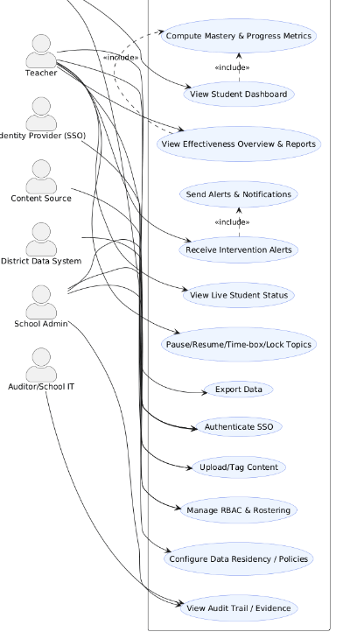
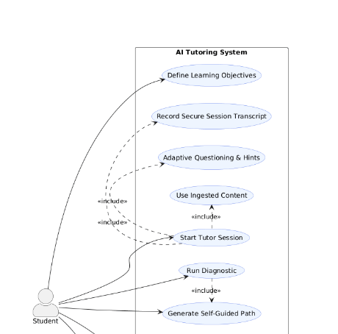
Documentation Of User Stories, Use Cases, and UML Diagrams
Use Case Diagrams

Slide 7
Installation and Evaluation of Existing Solution
Current methods of AI tutoring: MagicSchool, Khan Academy
The problem: These are not individualistic
Teachers control the learning, and the students have to adhere to rigid curriculums
Students should get more say in how they use their tutors to learn

Slide 8
Kanban Overview

Slide 9
Feature Demonstration
Implemented features:
Web based GUI for AI interaction.
Prompt safeguards ensuring safe responses
JSON and CSV based question and answer system for quizzes, to be fully implemented later.

Slide 10
Skills Identification and Learning Process
Zack:
Django templates
Gemini API
Prompt Safety
Jesse:
TailwindCSS design
Environment configuration
Luis:
JSON parsing
Environment configuration

Slide 11
Sprint Achievements and Challenges
Sprint 1 Achievements
Gathered client requirements & finalized documentation
Created user stories, use cases, and UML diagrams
Built early features:
Interactive AI tutor (Gemini API)
JSON quiz generation & grading
Web-based UI prototype
Strengthened skills in prompt engineering
Challenges & Solutions
Local LLM deployment — still in research; currently using Gemini API
Role-based access & authentication — database schema planed
Accessibility features — continuing next sprint
Backend logging & audit system — not yet integrated

Slide 12
Responsible Use of AI
Used ChatGPT to specify our project requirements
Improved our functional and non-functional requirements
Used to Github Copilot and ChatGPT to assist in debugging the prototype
All final work and decisions are done by our team.

Slide 13
Next Steps and Sprint Retrospective
Add teacher and admin dashboards
Implement student progress tracking, and intervention alerts
Develop role-based authentication and access control
Implement the landing page, and login/sign-up,

Slide 14
Conclusion
Thank you!

